Slide 1
Strategic decision in retail:
Retailer has to focus on strategic issues, which a retailing firm has to necessarily respond to. These include.
Location Decision.
Target market selection
Business model.
Merchandise mix
Positioning the retail store

Slide 2
a) Location decision:
Following location analysis should be considered
Demographic study of the population.
Psychographic profile of the population.
Size of the target market in that area.
Probable competition from other firms in that area.
Positioning of competition in the target market.
Real estate development in the area.
Business climate in the area.

Slide 3
Following factors affect a site attractiveness.
Accessibility.
At the Macro level
At the Micro level
Store Visibility
Store traffic flow.
Amount and quality of parking
2. Location Advantage

Slide 4
b) Target market selection
To select a target market, the retail organization has to consider the following factors:
Understanding the life style of the consumers.
Age group of the individual.
Spending capacity of the consumer.
Income level of the consumer.
Literacy level of the consumer
Gender.
Behavioral patterns of consumer
Social status
Environmental factors

Slide 5
c) Business model
Some business models in retail are:
Independent retail model.
Existing retail business model
Franchise retail business model.
Network marketing retail business model.

Slide 6
Traditional business models in Indian retail:
Traditional mom and pop stores.
Kiosks.
Street market.

Slide 7
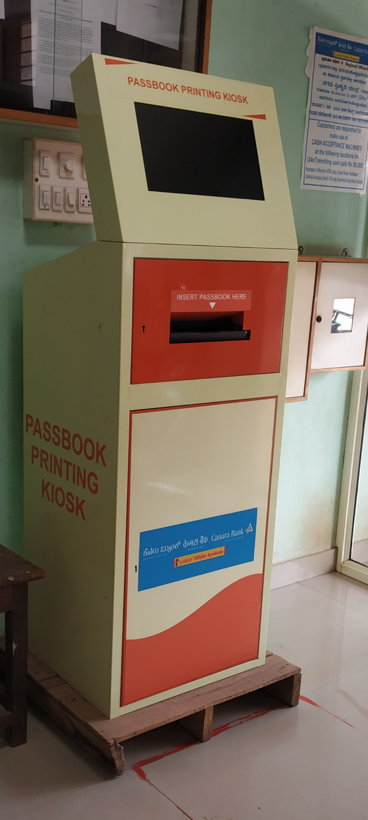
KIOSK

Slide 8
d) Merchandise mix:
Merchandise mix is the total set of all products offered for sale by a retailer.
In simple terms it refers to the breadth and depth of the products carried by retailers.

Slide 9
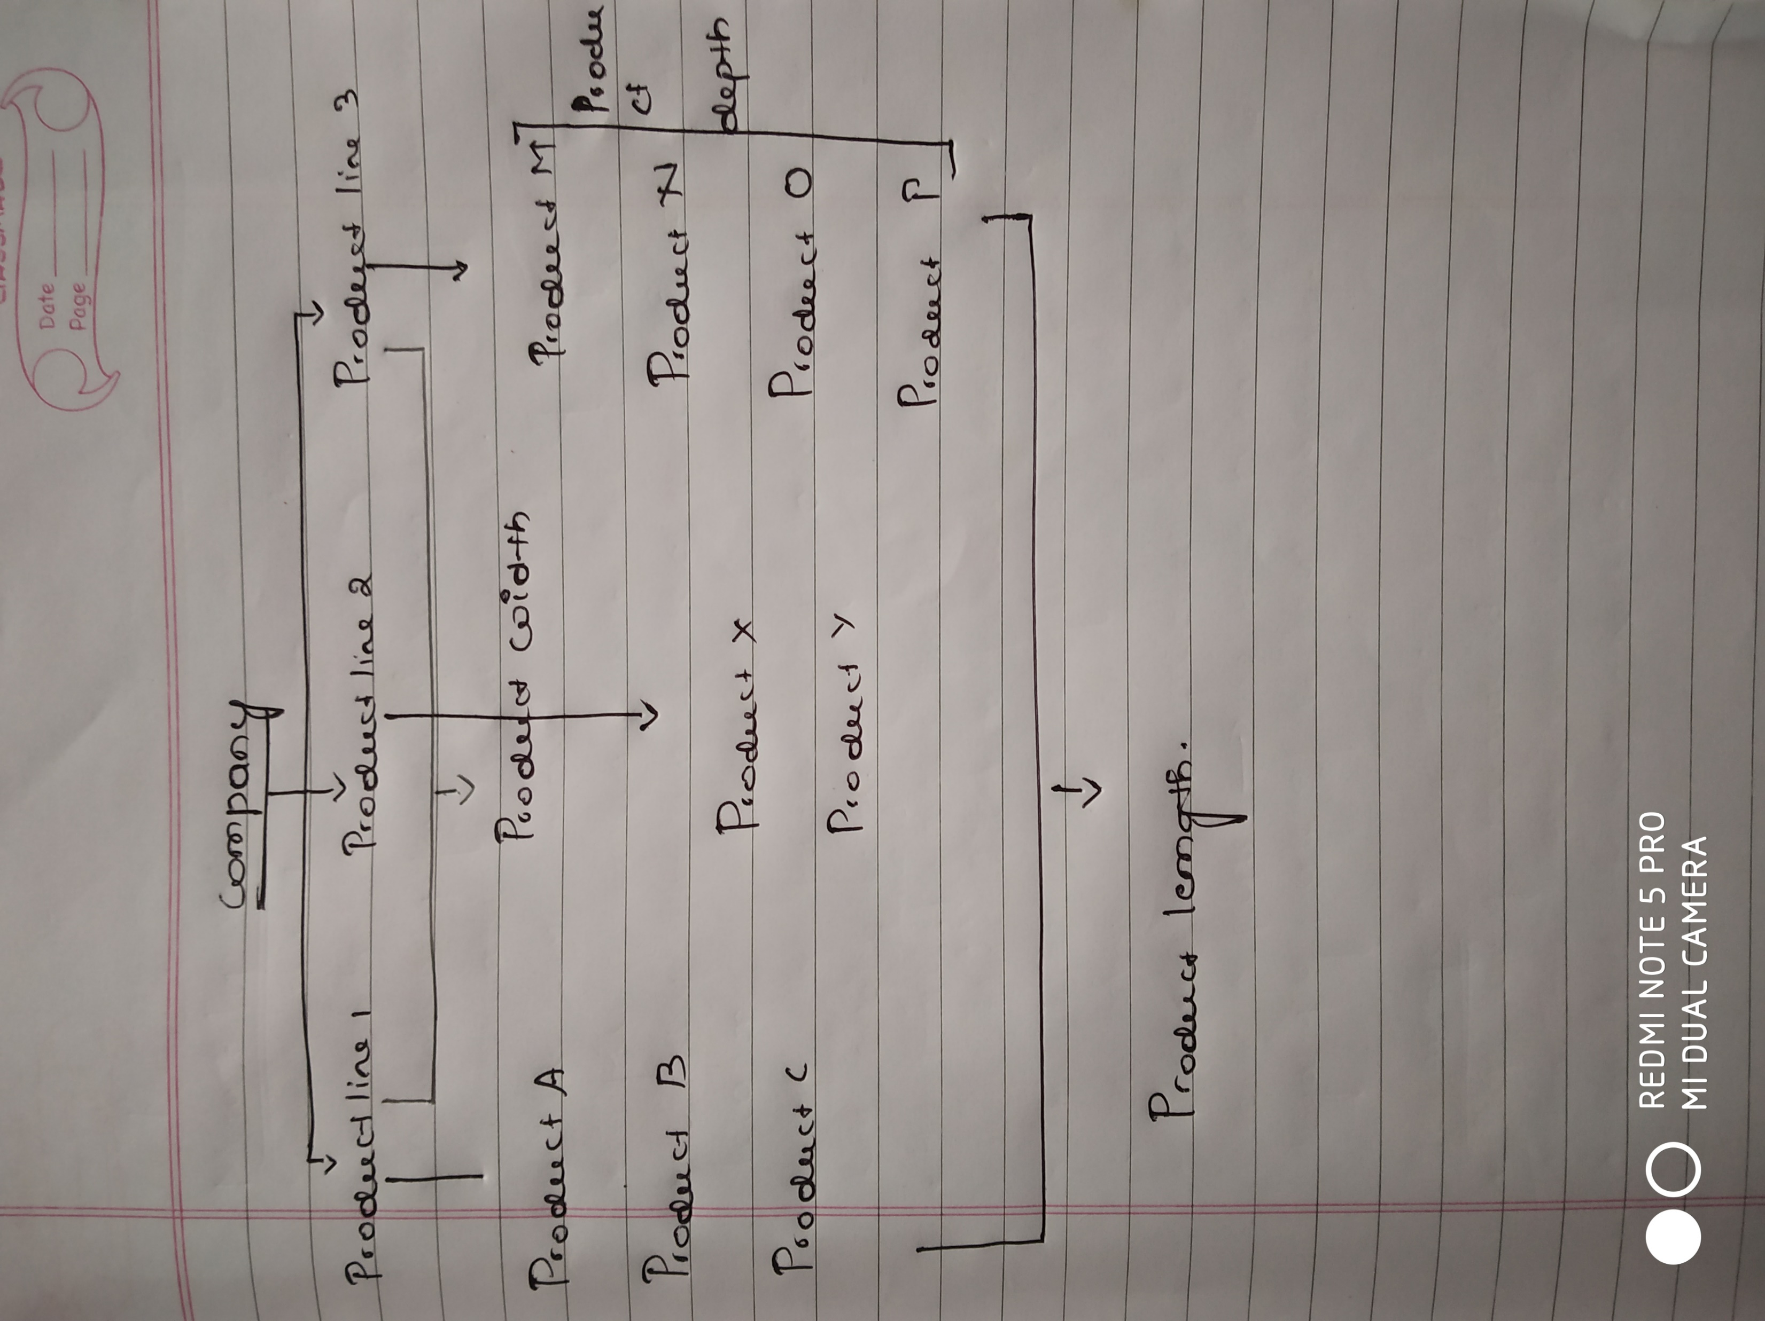
The areas for consideration in merchandise mix:

Slide 10
Product Breadth: It relates to the number of product lines a company produces
Ex: P&G – hair products, oral care, soaps, detergent, baby care and personal care.
2. Product Depth: Different version of products available in product line.
Ex: variety of size and flavors. (dairy milk)
3. Product Length: Total number of products sold with in product line
Ex: the company has 10 product line and each line has 3 products, then length (10X3 = 30)
4. Product consistency: It refers to how closely products are linked to each other.

Slide 11
e) Positioning retail store:
Store positioning is about creating an image and identity for the store.
It is essential to think about positioning before the promotion, place, price, product and people.

